Slide 1


STUDENT NAME: Keith Bhebe
SCHOOL: Computer Software
UNIVERSITY: Tianjin University
LECTURER：Eliza Dhasaiyan
Web Architecture and Application Development
nyashakeith@outlook.com
Health Score Calculator

Slide 2
01
CONTENTS
AIM OF THE PROJECT
02
GRAPHIC USER INTERFACE
03
SUMMARY
04
TOOLS USED

Slide 3
NO.1
AIM OF THE PROJECT

Slide 4
NO.1
AIM
A
A
TO HELP ORGANISE PATIENTS DATA
B
B
TO CALCULATE HEALTH SCORE FOR PEOPLE
C
C
TO ALSO PROVIDE PATIENTS PRIOR HISTORY FOR SCORING
D
D
TO HELP EVERYONE TO ALWAYS KNOW THEIR HEALTH SITUATION

Slide 5
NO.2
GRAPHIC USER INTERFACE

Slide 6
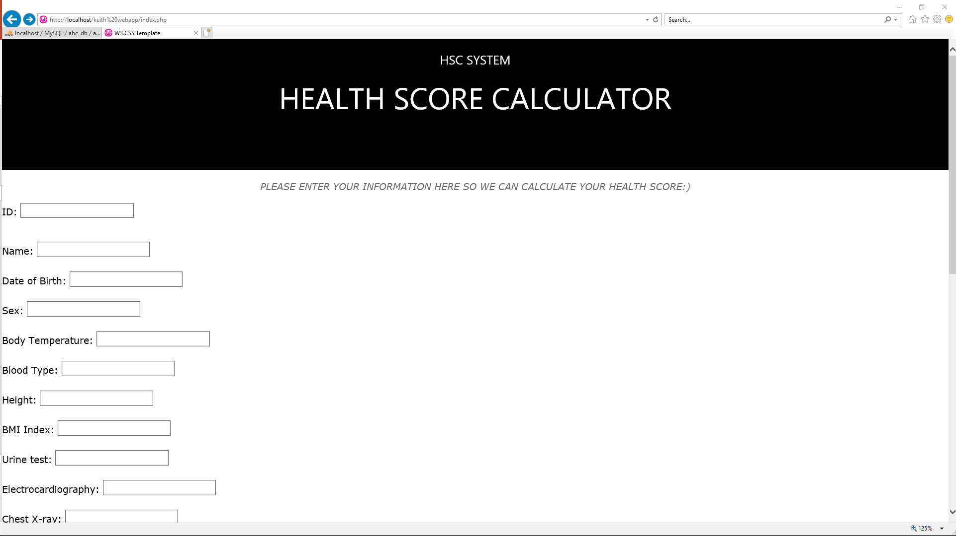


NO.2
作品概述
更换图片方法：点击图片后右键，选择“更改图片”即可。标题数字等都可以通过点击和重新输入进行更改，顶部“开始”面板中可以对字体、字号、颜色、行距等进行修改。建议正文8-14号字，1.3倍字间距。标题数字等都可以通过点击和重新输入进行更改。标题数字等都可以通过点击和重新输入进行更改。
01
点击此处添加标题
更换图片方法：点击图片后右键，选择“更改图片”即可。标题数字等都可以通过点击和重新输入进行更改，顶部“开始”面板中可以对字体、字号、颜色、行距等进行修改。
02
点击此处添加标题
更换图片方法：点击图片后右键，选择“更改图片”即可。标题数字等都可以通过点击和重新输入进行更改，顶部“开始”面板中可以对字体、字号、颜色、行距等进行修改。

Slide 7
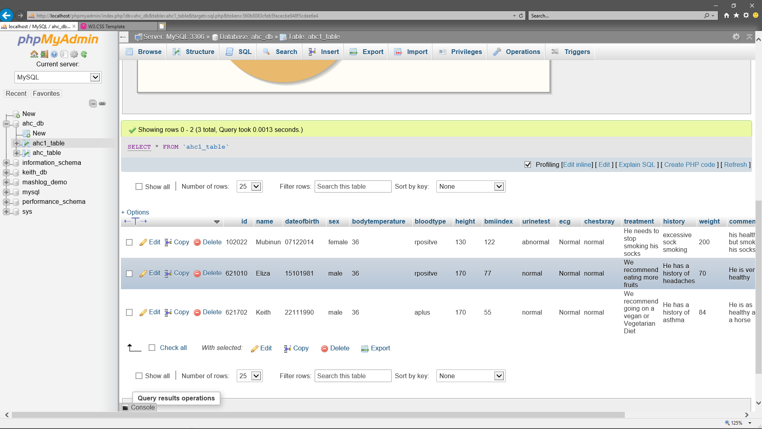
NO.2
作品概述
更换图片方法：点击图片后右键，选择“更改图片”即可。标题数字等都可以通过点击和重新输入进行更改，顶部“开始”面板中可以对字体、字号、颜色、行距等进行修改。建议正文8-14号字，1.3倍字间距。标题数字等都可以通过点击和重新输入进行更改。标题数字等都可以通过点击和重新输入进行更改。
01
点击此处添加标题
更换图片方法：点击图片后右键，选择“更改图片”即可。标题数字等都可以通过点击和重新输入进行更改，顶部“开始”面板中可以对字体、字号、颜色、行距等进行修改。
02
点击此处添加标题
更换图片方法：点击图片后右键，选择“更改图片”即可。标题数字等都可以通过点击和重新输入进行更改，顶部“开始”面板中可以对字体、字号、颜色、行距等进行修改。

Slide 8
NO.3
SUMMARY

Slide 9
NO.3
SUMMARY
A
A
TO HELP ORGANISE PATIENTS DATA
B
B
TO CALCULATE HEALTH SCORE FOR PEOPLE
C
C
TO ALSO PROVIDE PATIENTS PRIOR HISTORY FOR SCORING
D
D
TO HELP EVERYONE TO ALWAYS KNOW THEIR HEALTH SITUATION

Slide 10
NO.4
TOOLS USED

Slide 11
NO.4
PLATFORM
A
A
Dell Inspiron 7572 with specifications of i7-8550U CPU, 16.0GB RAM, 64-bit Windows 10 OS.
B
B
PHPADMIN, MYSQL DATABASE, BOOTSTRAP
C
C
NOTEPAD++ TEXT EDITOR
D
D
WAMPSERVER32

Slide 12
STUDENT NAME: Keith Bhebe
SCHOOL: Computer Software
UNIVERSITY: Tianjin University
LECTURER：Eliza Dhasaiyan
Web Architecture and Application Development
Health Score Calculator

Slide 13
THANK YOU

